Slide 1
Alberta’s Grazing Lease Framework
Grazing Lease Royalties
Background, proposed changes, rational and implementation.

Slide 2
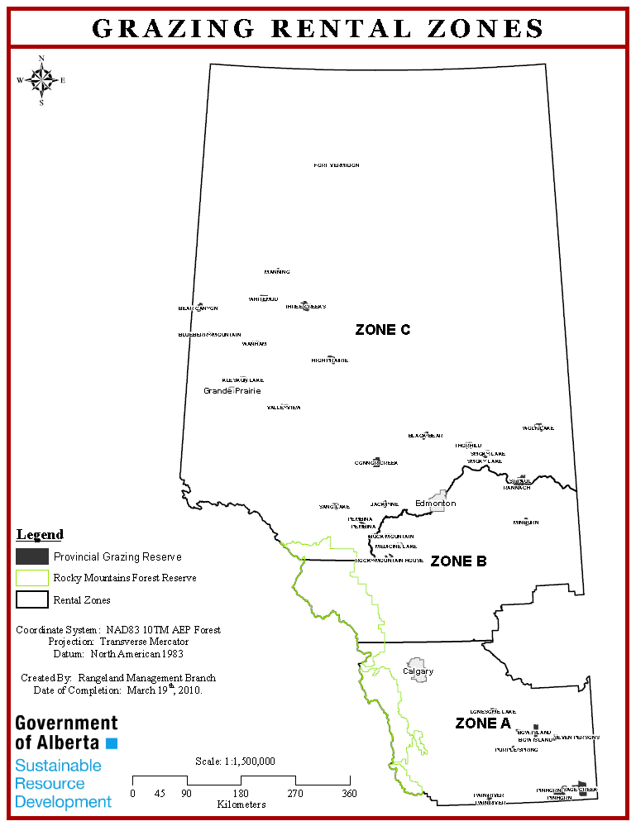
Background – Rental Rates
3-zone rental rate system implemented in 1960
Based on distance to livestock markets and outdated understanding of forage quality

Slide 3
Background – Rental Rates
Rental rates have been determined using the following formula based on the grazing capacity of the land, the average weight gain of cattle on grass, and the average sale price per pound of cattle:
Rent per AUM = (300lb. wt. gain/AU/yr) x (average lvstk. $/lb) x (zonal %)
12 months
Since 1994, the grazing rental rates for leases, licences and permits in Alberta have been frozen at:
Zone A (Southern Alberta) - $2.79/AUM
Zone B (Central Alberta) - $2.32/AUM
Zone C (Northern Alberta) - $1.39/AUM

Slide 4
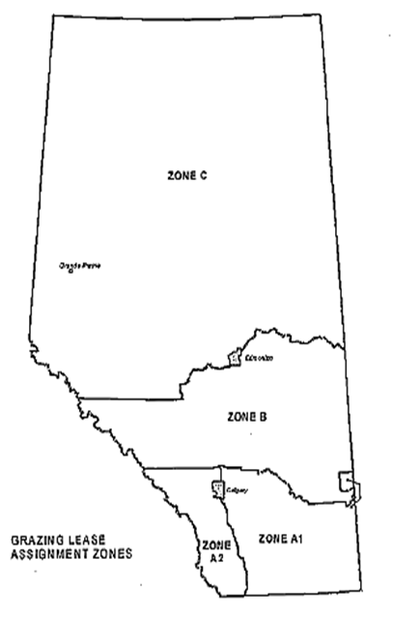
Background – Assignment Fees
Established at the same time as rental rates
Designed to capture 50% of the capitalized value of a grazing lease
These fees were originally calculated using a formula approach:
{BPC + (BPC*CPC) + Constant + (BPC*LVC)}*0.5
Where:
BCP – Base Period Consideration
CPC – Cattle Price Change
LVC – Land Value Change

Slide 5
Background – Assignment Fees
In 1994 the assignment fees calculated using the ‘Formula Approach’ were frozen along with rental rates at:
Zone A1 - $48.53/AUM
Zone A2 - $99.80/AUM
Zone B - $48.53/AUM
Zone C - $3.84/AUM
In 2003 assignment fees were incorporated into the Public Lands Act at their current fixed rates along with a minimum assignment fee of $100.00:
Zone A1 - $50.00/AUM
Zone A2 - $100.00/AUM
Zone B - $50.00/AUM
Zone C - $5.00/AUM

Slide 6
Review and Proposal Development
Late 2013 ESRD was approached by the livestock industry to review the grazing lease rental rate and assignment system with the intent to implement a new framework.
Stakeholder committee established with representatives from:
Alberta Grazing Leaseholders Association
Alberta Beef Producers
Western Stock Growers
Northern Alberta Grazing Leaseholders Association
Committee worked closely with Environment and Sustainable Resource Development to create a new framework for grazing rental rates and assignment fees on public lands.

Slide 7
List of Objectives
A new rental rate formula and assignment fee schedule should:
Have comparable methodology to other resource sectors
Remove existing barriers to succession or the entry of young people into the industry that result from the current rental rate formula or assignment fee schedule
Promote and encourage good stewardship
Be defendable to economic threats such as countervail
Be justifiable - to the Alberta public, other provinces and other resource sectors
Must also be justifiable to grazing lease holders – with rental rates applied fairly across the province based on geographical cost differences
Support the maintenance of native grasslands and recognize the interconnections between public and private grasslands
Recognize the contributions of good management and private capital to the system
Be fair to both leaseholders and government
Be revenue neutral over the long term and not specifically intended to increase revenue to the Government nor to decrease rental paid by leaseholders

Slide 8
List of Items Committee Supports
To use a market-based administrative formula
Similar to lumber stumpage, deciduous timber, OSB, pulp and conventional oil and gas
The new royalty structure will be based on a 2 zone system
The new royalty structure will be based on the following minimums:
Zone 1 Minimum - $2.30
Zone 2 Minimum - $1.30
The new royalty structure will start at a 10% incremental variable component as variable income before royalties, taxes and capital return becomes positive.
Costs incorporated into formula are appropriate and justified
Using the Consumer Price Index (CPI) to inflate costs between survey periods is justified and agreed upon

Slide 9
List of Items Committee Supports
Use a 2 year rolling average to even out market fluctuations
A phase in period of 5 years based on positive increases and 20% increments
Part of the proceeds from grazing lease royalties should go to the Range Sustainability Fund
Committee agreed on a 40% contribution, mimicking the Forest Resource Improvement Program managed by Forest Resource Improvement Association of Alberta and funded by a percentage of timber dues paid by industry
Assignment fees will be a flat rate throughout the province that reflects the cost of administration
There will be a review of the system in 5 years to ensure that industry is comfortable with the new formula and zones
Government would have to resurvey costs periodically (every 10 years) to ensure that formula is accurate

Slide 10
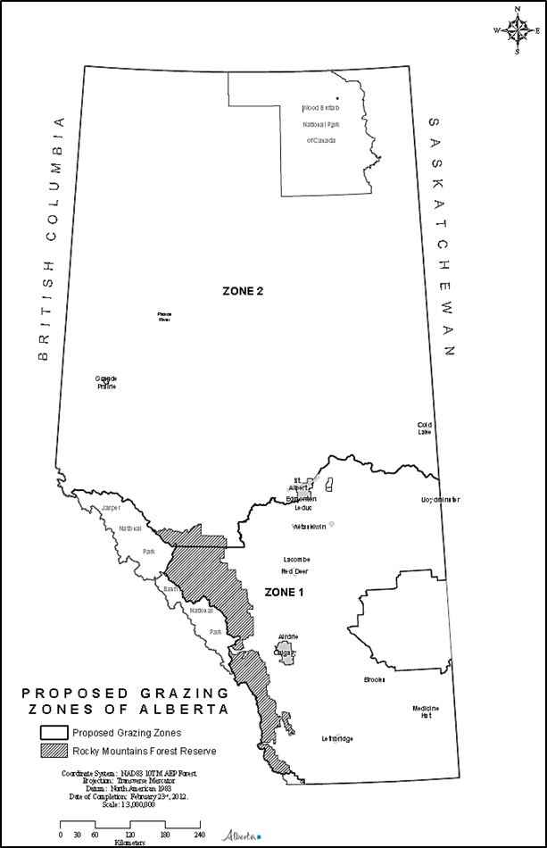
Proposed Grazing Zones
The stakeholder committee and ESRD agreed to a new two zone grazing rental rates structure with a boundary based on the transition to the boreal region of the province - an area that incurs higher capital costs on grazing leases.
The two zones would have different minimum rental rates to reflect these differences in capital costs:
Zone 1 - $2.30/AUM
Zone 2 - $1.30/AUM

Slide 11
Proposed Rental Rate Formula
Formula is:
Yearling cattle market value
Less Additional input costs
Less Grazing lease investment
and operating costs
Equals Grazing lease rental rate

Slide 12
Current Rental Rates | Proposed Rental Rates
Rental rate revenue has remained ~$2.9M since the formula has been frozen. | Rental rate revenue would, on average, be maintained or increased. Minimum rental rate revenue would be ~$2.5M when cattle prices are depressed and rental rates are at their minimums
Rental rate formula not aligned with other provincial royalty systems. | Proposed rental rate formula aligned with timber stumpage, deciduous timber, OSB and pulp, conventional oil and gas and oil sands royalties.
Rental rate formula calculated using: Weight gain of cattle. Average price of cattle. Zone percentages (based on grazing zones). | Rental rate formula calculated using: Market value of cattle. Input, investment and operating costs of disposition holder (Grazing Lease Cost Study).
Three grazing zones with separate rates and zonal royalties: Zone A = $2.79/AUM (rent); 10% (royalty) Zone B = $2.32/AUM (rent); 8^{1/3} % (royalty) Zone C = $1.39/AUM (rent); 5% (royalty) Originally designed to account for longer distance to market faced by northern producers and to encourage settlement of northern Alberta. No rational for the different charges per AUM in the grazing zones. Zonal royalties are fixed for each grazing zone. | Elimination of three grazing zones and replacement with a two zone system that captures minimum rental rate of $2.30/AUM in Zone 1 and $1.30/AUM in Zone 2 with incremental royalties increasing as profits increase: ↑ cattle prices = ↑ royalties ↓ cattle prices = ↓ royalties (to $2.30 or $1.30/AUM) Distance to market no longer applicable, more options available to producers. Incremental royalties are responsive to market conditions and equal across the Province.
Rental rates have been frozen since 1994 due to concerns over the inequality of the grazing zones. Lacks transparency (both formula and frozen fees). Not based on relevant cost structures incurred by leaseholder. Unresponsive to market conditions (frozen fees). | Proposed rental rate formula applies a two zone formula that would be calculated each year. Transparent and defendable (industry-driven proposal). Based on relevant cost structures incurred by leaseholders (cost study). Responsive to market conditions.

Slide 13
Proposed Rental Rates
Year of Rental Rate | Sept Beef Price of Previous Year | Zone 1 (851,933 AUMs) | Zone 2 (442,582 AUMs) | Total Paid in $ million (1,294,515 AUMs)
2013 | $1.38 | $2.51 | $1.51 | $2.81
2014 | $1.45 | $3.28 | $2.28 | $3.80
2015 | $2.10 | $6.88 | $5.88 | $8.46
2016 | $2.20 | $10.51 | $9.51 | $13.16
2017 | $1.85 | $8.22 | $7.22 | $10.20
2018 | $1.65 | $6.00 | $5.00 | $7.32
2019 | $1.50 | $4.42 | $3.42 | $5.28
2020 | $1.25 | $3.37 | $2.37 | $3.92
2021 | $1.10 | $2.37 | $1.37 | $2.63
2022 | $1.00 | $2.30 | $1.30 | $2.53

Slide 14
Phased Implementation
Grazing lease rental rate changes will be phased in over a five year period (2016-2020).
During this time, rental rates will be calculated as the base rate plus an annually increasing percentage of the premium beyond the base rate.
If, due to market declines, there is a crossover in rental rates during the phased implementation, rental rates will default to the full rates.
A crossover occurs when a full rate is less than the prior years partial rate.
In the following example, a crossover in rental rates occurs in 2019.

Slide 15
Phased Rental Rates*
Year of Rental Rate | Sept Beef Price of Previous Year | Full Premium | Phased Premium |  | Zone 1 (851,933 AUMs) | Zone 2 (442,582 AUMs) | Total Paid in $ million (1,294,515 AUMs)
2013 | $1.38 | $0.21 | n/a | n/a | n/a | n/a | n/a
2014 | $1.45 | $0.98 | n/a | n/a | n/a | n/a | n/a
2015 | $2.10 | $4.58 | n/a | n/a | n/a | n/a | n/a
2016 | $2.20 | $8.21 | 20% | $1.64 | $3.94 | $2.94 | $4.66
2017 | $1.85 | $5.92 | 40% | $2.37 | $4.67 | $3.67 | $5.60
2018 | $1.65 | $3.70 | 60% | $2.22 | $4.52 | $3.52 | $5.41
2019 | $1.50 | $2.12 | 80% 100% | $1.70 $2.12 | $4.00 $4.42 | $3.00 $3.42 | $4.73 $5.28
2020 | $1.25 | $1.07 | 100% | $1.07 | $3.37 | $2.37 | $3.92
2021 | $1.10 | $0.07 | 100% | $0.07 | $2.37 | $1.37 | $2.63
2022 | $1.00 | $ - | 100% | $0.00 | $2.30 | $1.30 | $2.53
* The phased premium would be eliminated when the current year’s full premium is less than the prior year’s partial or phased premium – in this example that occurs in 2019.

Slide 16
Crossover

Slide 18
Assignment Fees
Assignment fees will be a flat rate throughout the province that reflects the cost of administration
Not based on a per AUM fee

Slide 19
Current Assignment Fees | Proposed Assignment Fees
Assignment fees were designed to recover 50% of the capitalized value of a disposition resulting from such factors as grazing rights and rental rates. | Proposed assignment fees will cover the administrative costs of registering the assignment.
Assignment fee charged based on carrying capacity of land: $ /AUM | Administrative cost not based on carrying capacity.
These fees were originally calculated using a formula approach: {BPC + (BPC*CPC) + Constant + (BPC*LVC)}*0.5 BCP – Base Period Consideration CPC – Cattle Price Change LVC – Land Value Considers: Percentage change in cattle prices. Percentage change in grazing land values in four zones. Base period consideration. | Fee that reflects the actual administrative cost of registering the assignment.
Assignment fees calculated using the “Formula Approach” were frozen in 1994: Zone A1 = $48.53/AUM Zone A2 = $99.80/AUM Zone B = $48.53/AUM Zone C = $3.84/AUM | Elimination of assignment fee zones.
In 2003, assignment fees for “Arms-Length Transfers” incorporated into Public Lands Act at the following fixed rates: Zone A1 = $50/AUM Zone A2 = $100/AUM Zone B = $50/AUM Zone C = $5/AUM Five other assignment types were established in 2003 under the Act with a flat $100 assignment fee charge. | Elimination of assignment fee zones and incorporation of assignment fees into the Public Lands Administration Regulation Elimination of different categories of assignments.
Assignment fees are not transparent: Based on outdated and cumbersome “Formula Approach”. Not consistent across province Dependent on a variety of transfer types. Not reflective of the cost of assigning the disposition. | Assignment fees would be transparent: Not based on a cumbersome formula. Applied consistently across the province. Not differentiated by transfer types. Based on administrative costs to register the assignment.

Slide 20
Range Sustainability Fund
Range Sustainability Fund contributions would be 40% of the rental royalties and would apply to minimum rents as well as any increased rental rates.
The fund would be used for research and extension opportunities that help to inform Albertans about the benefits of ranching, such as environmental stewardship.
Projects that could be funded by the program include:
Pasture health assessment tool development
Rangeland and riparian monitoring and management
Rangeland stewardship and adaptation
Wildlife, livestock and rangeland interactions, livestock producer education and extension
Recreation and rangeland interaction
Industry and resource use integration
Producer training/awareness
Range health research – reclamation/restoration
Wolf predation and cattle loss studies
Grazing and timber integration
The department would use the fund to partner with groups such as: Cows and Fish, Rocky Mountain Forest Range Association, Alberta Beef Producers, Alberta Grazing Leaseholders Association, Western Stockgrowers, Alberta Native Plant Council, Southwest Alberta Sustainable Community Initiative, etc.

Slide 21
Questions
Market Based Rents for Grazing Leases

